Slide 1

6th Grade Math
Unit 10, Lesson 1 Creating Box Plots Volume 2, pg. 203

Slide 2


Benchmarks
MA.6.DP.1.3
Given a box plot within a real-world context, determine the minimum, the lower quartile, the median, the upper quartile and the maximum. Use this summary of the data to describe the spread and distribution of the data.
MA.6.DP.1.5
Create box plots and histograms to represent sets of numerical data within real-world contexts.
volume 2, pg. 203

Slide 3
Integrated Mathematical Thinking and Reasoning Standards
MA.K12.MTR.2.1 Demonstrate understanding by representing problems in multiple ways.
MA.K12.MTR.4.1 Engage in discussions that reflect on the mathematical thinking of self and others.
MA.K12.MTR.7.1 Apply mathematics to real-world contexts.
volume 2, pg. 203

Slide 4

Learning Targets
I can find key values given a box plot within a real‑world context.
I can create a box plot to represent data.
volume 2, pg. 203

Slide 5

Warm-Up
volume 2, pg. 203

Slide 6
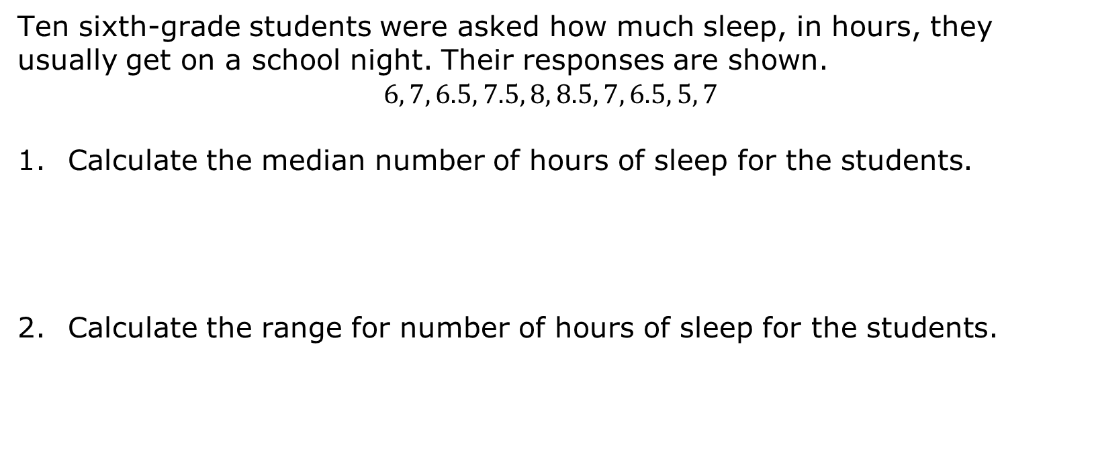
10.1.1 Warm-Up: Sleep
Ten sixth-grade students were asked how much sleep, in hours, they usually get on a school night. Their responses are shown.
$$6, 7, 6.5, 7.5, 8, 8.5, 7, 6.5, 5, 7$$
Calculate the median number of hours of sleep for the students.
Calculate the range for number of hours of sleep for the students.
volume 2, pg. 203

Slide 7

Refresher
volume 2, pg. 204

Slide 8

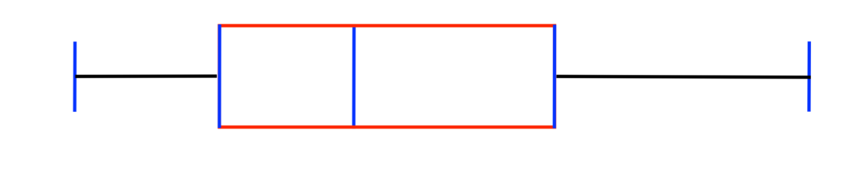
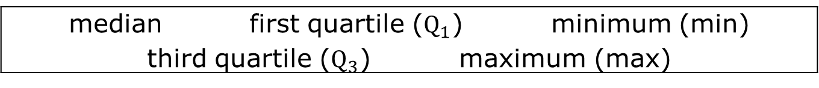
10.1.2 Refresher: Box Plots
A blank box plot is shown. Label the blue boxes below using the words found in the bank.
median first quartile ($Q_{1}$) minimum (min) third quartile ($Q_{3}$) maximum (max)
volume 2, pg. 204

Slide 9
Complete the statements.
The __________________________ is a measure of spread determined by finding the distance between the first quartile and the third quartile. It measures the spread of the middle ____________ of the data.
The ______________ is another measure of spread determined by finding the difference between the largest data value and the smallest data value.
volume 2, pg. 204

Slide 10
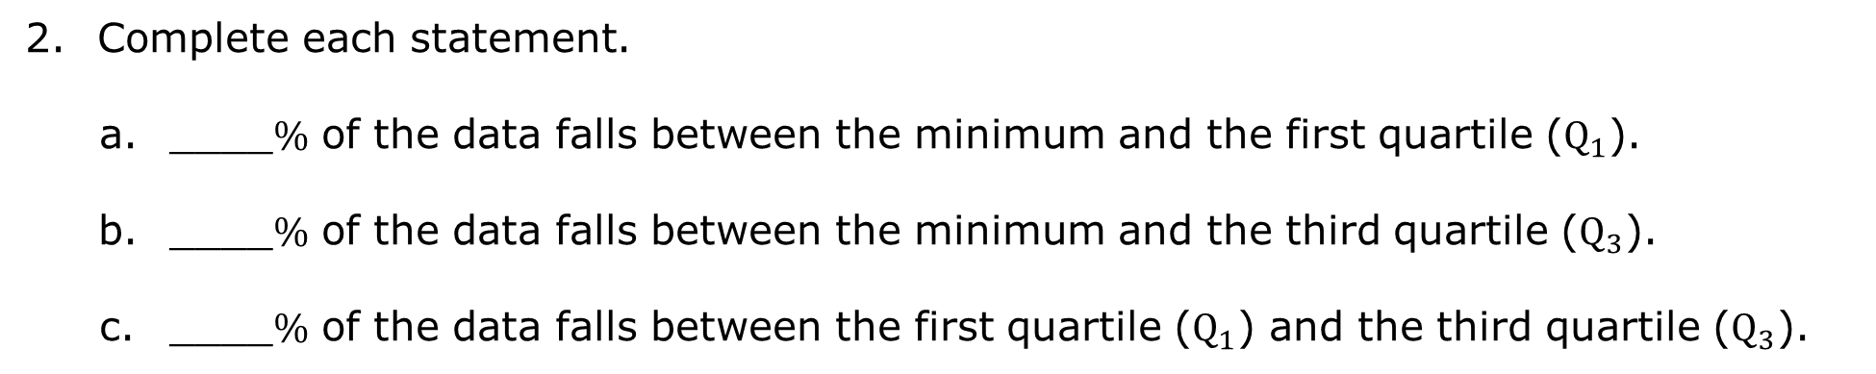
Complete each statement.
____$\%$ of the data falls between the minimum and the first quartile ($Q_{1}$).
____$\%$ of the data falls between the minimum and the third quartile ($Q_{3}$).
____$\%$ of the data falls between the first quartile ($Q_{1}$) and the third quartile ($Q_{3}$).
volume 2, pg. 204

Slide 11
The box plot shows the distribution of the daily number of people who were at a large community pool in July 2018.
Number of Patrons at Community Pool
What is the median number of people at the pool each day?
What is the maximum number of people?
What is the minimum number of people?
volume 2, pg. 204

Slide 12

Number of Patrons at Community Pool
Determine the value of the first quartile ($Q_{1}$) from the box plot.
Determine the value of the third quartile ($Q_{3}$) from the box plot.
volume 2, pg. 204

Slide 13

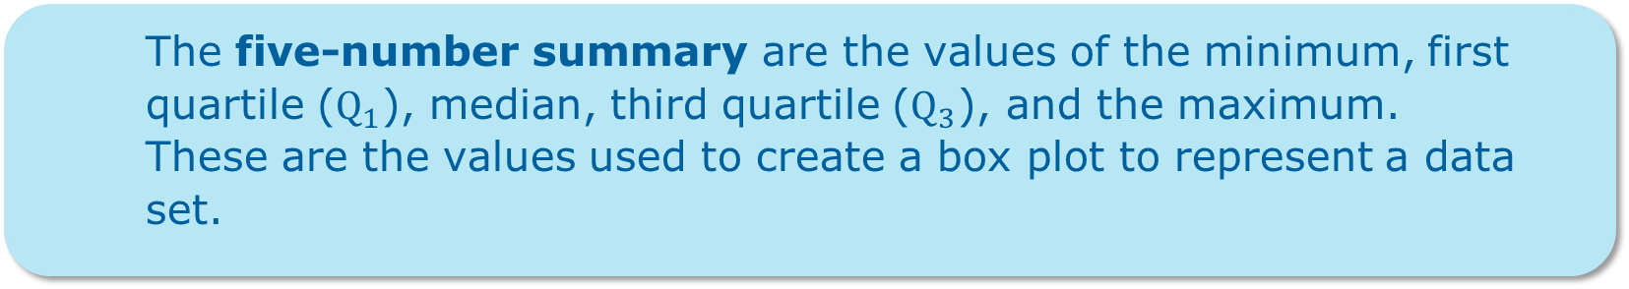
The five-number summary are the values of the minimum, first quartile ($Q_{1}$), median, third quartile ($Q_{3}$), and the maximum.
These are the values used to create a box plot to represent a data set.
volume 2, pg. 204

Slide 14

Guided Instruction
volume 2, pg. 205

Slide 15
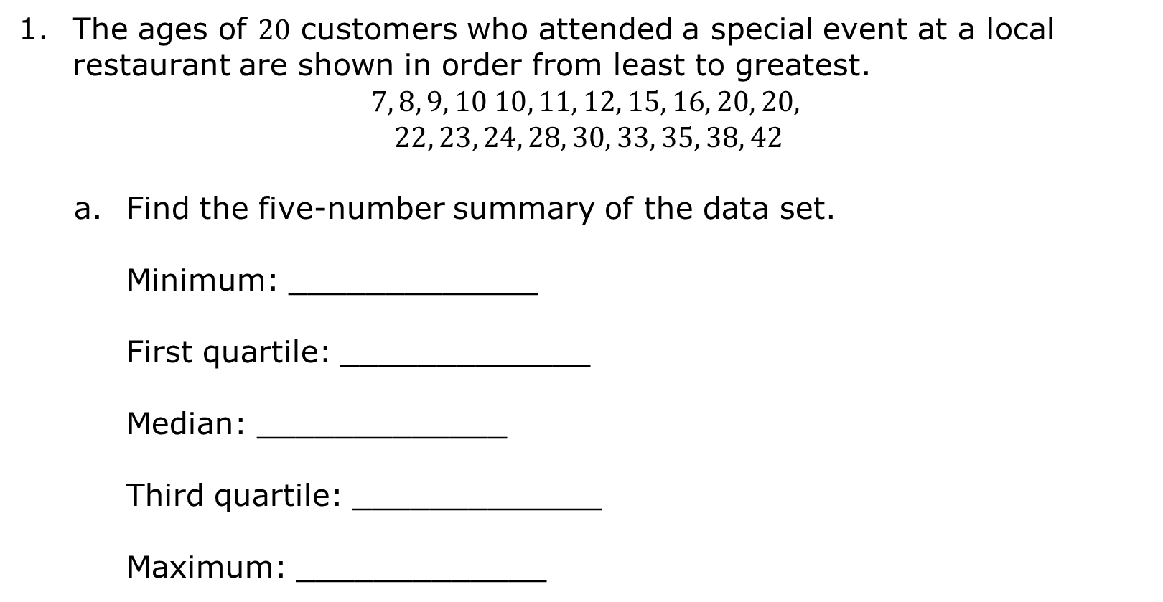
10.1.3 Guided Instruction: The Five-Number Summary
The ages of $20$ customers who attended a special event at a local restaurant are shown in order from least to greatest.
$$7, 8, 9, 10 10, 11, 12, 15, 16, 20, 20,$$
$$22, 23, 24, 28, 30, 33, 35, 38, 42$$
Find the five-number summary of the data set.
Minimum: _____________
First quartile: _____________
Median: _____________
Third quartile: _____________
Maximum: _____________
volume 2, pg. 205

Slide 16
Discuss with your partner if the data the restaurant collected is reflective of the ages of customers who ate at the restaurant.
Truthful data is data that is random, representative of the population, and has a large sample size.
volume 2, pg. 205

Slide 17
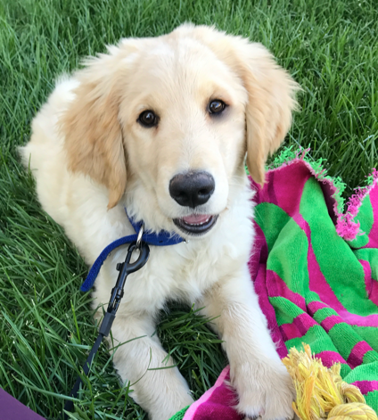
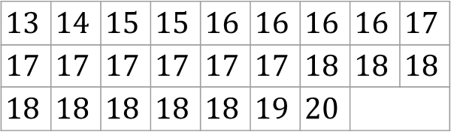
The birth weights, in ounces, of golden retriever puppies born at a kennel were recorded for the past month. The data is recorded in the table.
$$13$$ | $$14$$ | $$15$$ | $$15$$ | $$16$$ | $$16$$ | $$16$$ | $$16$$ | $$17$$
$$17$$ | $$17$$ | $$17$$ | $$17$$ | $$17$$ | $$17$$ | $$18$$ | $$18$$ | $$18$$
$$18$$ | $$18$$ | $$18$$ | $$18$$ | $$18$$ | $$19$$ | $$20$$
Find the five-number summary of the data set.
Minimum: _____________
First quartile: _____________
Median: _____________
Third quartile: _____________
Maximum: _____________
volume 2, pg. 205

Slide 18
Discuss with your partner why the data may not be a true representation of the birth weight of all puppies.
What differences did you notice when calculating the five-number summary for the two different data sets?
volume 2, pg. 205

Slide 19
An illustration of the five-number summary for an even data set is shown.
An illustration of the five-number summary for an odd data set is shown.
Lower Half
Upper Half
Median
Lower Half
Upper Half
Median
volume 2, pg. 206

Slide 20
Discuss with your partner your observations and any questions you have about the illustrations.
volume 2, pg. 206

Slide 21

Guided Practice
volume 2, pg. 206

Slide 22

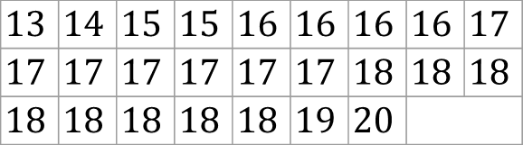
10.1.4 Guided Practice: Creating a Box Plot
Using the data and five-number summary on the birth weight, in ounces, of the golden retriever puppies born at a kennel in the last month, create a box plot from the steps listed.
Step 1: Label the axis by starting at a number slightly less than the minimum. Increase by the same interval, making sure each interval is equally spaced, until you reach (or pass) the maximum.
$$13$$ | $$14$$ | $$15$$ | $$15$$ | $$16$$ | $$16$$ | $$16$$ | $$16$$ | $$17$$
$$17$$ | $$17$$ | $$17$$ | $$17$$ | $$17$$ | $$17$$ | $$18$$ | $$18$$ | $$18$$
$$18$$ | $$18$$ | $$18$$ | $$18$$ | $$18$$ | $$19$$ | $$20$$
volume 2, pg. 206

Slide 23
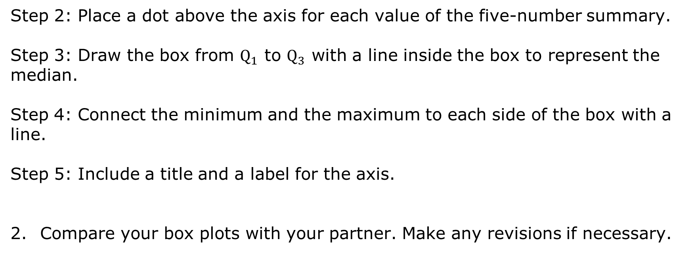
Step 2: Place a dot above the axis for each value of the five-number summary.
Step 3: Draw the box from $Q_{1}$ to $Q_{3}$ with a line inside the box to represent the median.
Step 4: Connect the minimum and the maximum to each side of the box with a line.
Step 5: Include a title and a label for the axis.
Compare your box plots with your partner. Make any revisions if necessary.
volume 2, pg. 206

Slide 24

Try It
volume 2, pg. 207

Slide 25

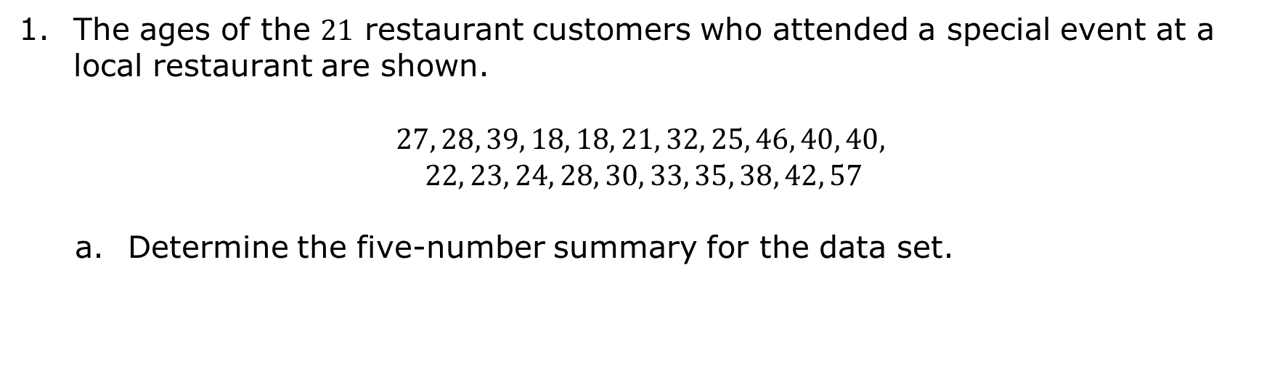
10.1.5 Try It: Creating a Box Plot
The ages of the $21$ restaurant customers who attended a special event at a local restaurant are shown.
$$27, 28, 39, 18, 18, 21, 32, 25, 46, 40, 40,$$
$$22, 23, 24, 28, 30, 33, 35, 38, 42, 57$$
Determine the five-number summary for the data set.
volume 2, pg. 207

Slide 26

Create a box plot using the data and five-number summary for the $21$ restaurant customers.
Does the length of each part of the box plot need to be the same?
volume 2, pg. 207

Slide 27
Why is the actual length of each part not equal, even though they each represent 25% of the data?
What is the interquartile range for the data?
What is the range?
volume 2, pg. 207

Slide 28

Your Turn
volume 2, pg. 208

Slide 29
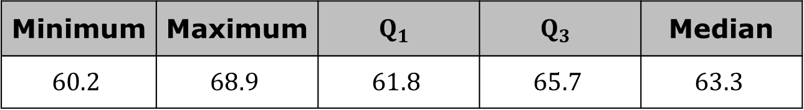
10.1.6 Your Turn!
Tom Brady is considered by most to be one of the best NFL quarterbacks of all time. The five-number summary for his pass-completion percentages from 2000 to 2009 is shown.
Discuss with your partner why the data used to determine the five-number summary for Tom Brady’s pass completion is more truthful than the data for golden retriever puppies, or the ages of the restaurant customers who attended a special event.
Minimum | Maximum | $$Q_{1}$$ | $$Q_{3}$$ | Median
$$60.2$$ | $$68.9$$ | $$61.8$$ | $$65.7$$ | $$63.3$$
volume 2, pg. 208

Slide 30
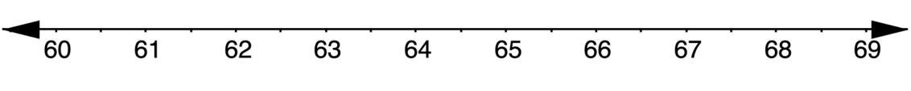
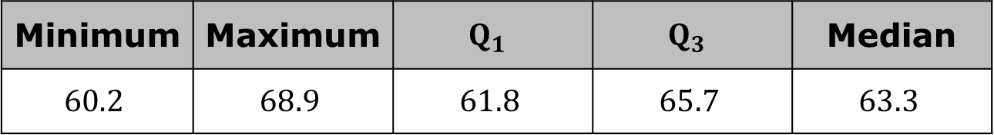
Use the five-number summary to draw and label a box plot of the data set.
Tom Brady’s Completion Percentages 2000-2009
Minimum | Maximum | $$Q_{1}$$ | $$Q_{3}$$ | Median
$$60.2$$ | $$68.9$$ | $$61.8$$ | $$65.7$$ | $$63.3$$
volume 2, pg. 208

Slide 31
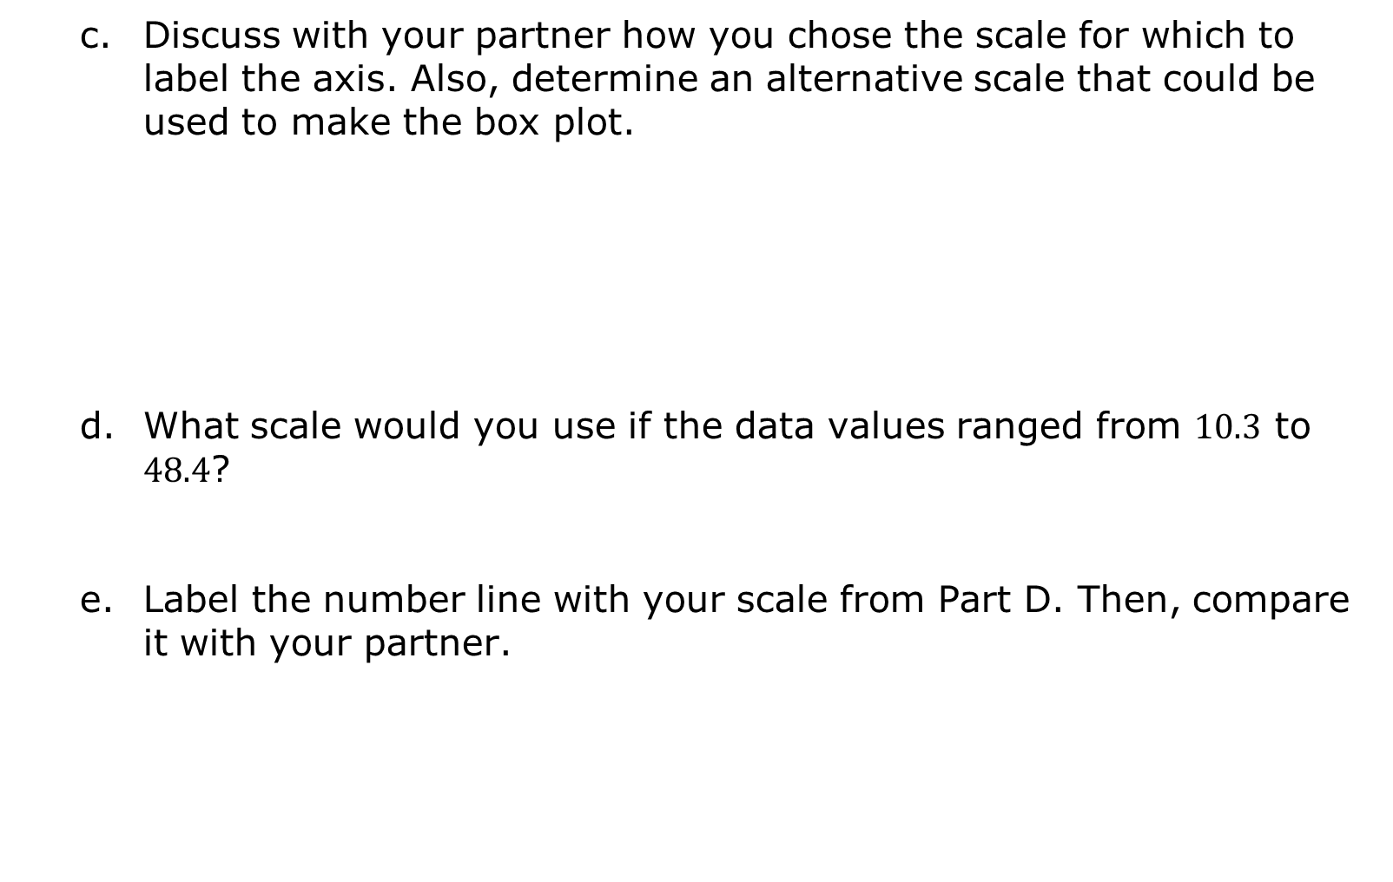
Discuss with your partner how you chose the scale for which to label the axis. Also, determine an alternative scale that could be used to make the box plot.
What scale would you use if the data values ranged from $10.3$ to $48.4$?
Label the number line with your scale from Part D. Then, compare it with your partner.
volume 2, pg. 208

Slide 32
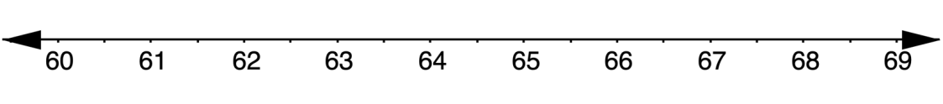
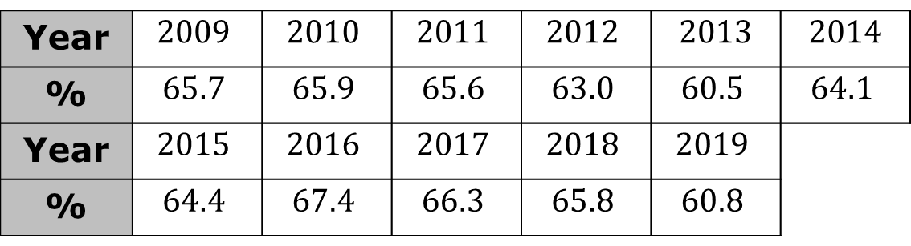
Tom Brady’s pass-completion percentages from 2009 to 2019 are listed in the table.
Create a box plot of Tom Brady’s pass-completion percentages.
Tom Brady’s Pass-Completion Percentages 2009-2019
Year | $$2009$$ | $$2010$$ | $$2011$$ | $$2012$$ | 2013 | 2014
% | $$65.7$$ | $$65.9$$ | $$65.6$$ | $$63.0$$ | $$60.5$$ | $$64.1$$
Year | $$2015$$ | $$2016$$ | $$2017$$ | $$2018$$ | $$2019$$
% | $$64.4$$ | $$67.4$$ | $$66.3$$ | $$65.8$$ | $$60.8$$
volume 2, pg. 209

Slide 33
Determine the interquartile range for Tom Brady’s pass-completion percentages.
What is the range of pass-completion percentages?
volume 2, pg. 209

Slide 34

Wrap-Up
volume 2, pg. 209

Slide 35
10.1.7 Wrap-Up: Reflection
Place an X on the line to indicate your understanding of creating box plots. Then provide a brief explanation or evidence to support your self-assessment.
I can find the five-number summary of a data set.
I need help. I can’t get started. | I’m getting there. | I understand and have evidence.
volume 2, pg. 209

Slide 36
I can create an axis with the appropriate scale.
I can find and interpret the interquartile range.
I need help. I can’t get started. | I’m getting there. | I understand and have evidence.
I need help. I can’t get started. | I’m getting there. | I understand and have evidence.
volume 2, pg. 209

